Slide 1
Module 7
Intuit, the City of Edmonton, Kilgore, Middle Eastern Oil and Gas, and Malaysia’s Media all integrating ERM

Slide 2
Chapter 12
Measuring Performance at Intuit: A Value-Added Component in ERM Programs

Slide 3

Notes:
History of ERM at Intuit - pg 227-228
Began as ad hoc reactive risk management scattered throughout the organization
2009 established the foundation of the ERM program
Enterprise-wide common risk framework
Inclusive of annual assessment cycle
Integrated into strategic planning processes.
Main focus of ERM is building a sustainable risk management capability continuously
Core principles of ERM – pg 228
Common risk framework enterprise-wide
Assessing risks on an ongoing basis
Focusing on the most significant risks
Clearly defined ownership and accountability for risk management
Performance measurement and monitoring
ERM Maturity model – pg 229
Ad hoc risk management
Addresses specific problems or on the fly issues
Targeted risk management
Independent risk management activities limited to a set of specific risk areas
Integrated risk framework
A common, respectable enterprise framework inclusive of ownership, accountability, and performance reporting

Slide 4
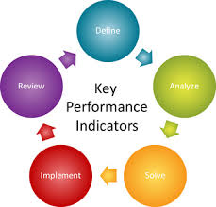
Notes:
ERM Program Performance 0 pg 230-
Measurement of performance through key risk indicators (KRI)
Understand how potential emerging risks or trends may impact current risks, opportunities, and strategies
Measure the effectiveness of risk management activities
Biggest challenge is knowing what to measure
KPI’s must be able to be tangible, flexible, standardized, and outcome or objective focused
Performance Analysis of Data – pg 232-233
Data analysis transforms the performance information to make it useful input, which in turn assists leaders in making informed decisions
Failure mode and effects analysis – FMEA - identifies potential failure points based on certain conditions and assists in mitigation planning
Regression analysis – provides information on the relationship between one dependent variable and one or more independent variables to understand the correlation between different risks
Pareto analysis – measures the frequency of issues from most to least frequent and allows decisions to be made focused on timeliness and severity
Root cause analysis – designed to identify and correct the fundamental root cause of the problem
Scenario analysis – uses specific scenarios to understand potential outcomes
Benchmarking – comparing company practices to best practices in the industry
Threat analysis – Evaluate broad spectrum of areas for threats – weather, natural disasters, criminal activity, legal, regulatory, technology, etc..

Slide 5
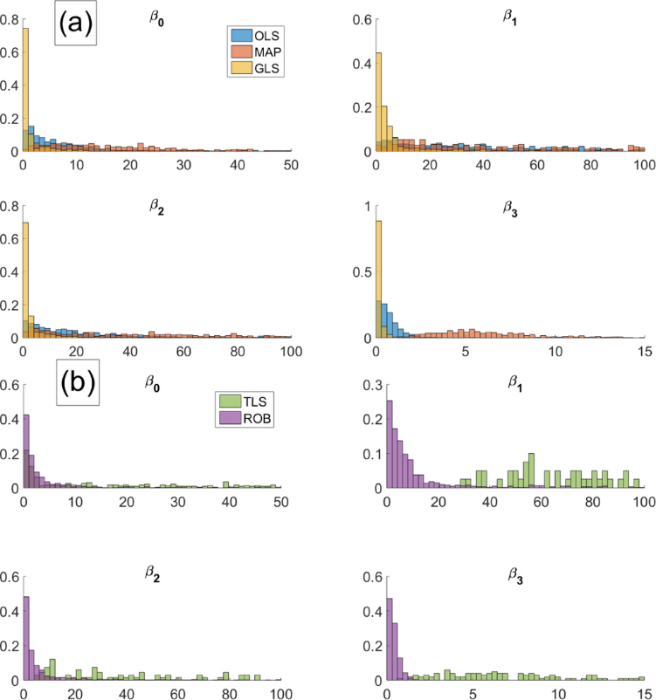
ERM Regression Analysis Example Report
https://www.bing.com/images/search?view=detailV2&ccid=7VHK52tS&id=04B8A108A576723209E6022F405AA7C1EC444A51&thid=OIP.7VHK52tSCgWyqqNyNoPEwQEYEs&mediaurl=http%3a%2f%2fwww.mdpi.com%2fentropy%2fentropy-17-04602%2farticle_deploy%2fhtml%2fimages%2fentropy-17-04602f3-1024.png&exph=1094&expw=1024&q=ERM+Regression+analysis&simid=608048782716963121&selectedIndex=5&ajaxhist=0

Slide 6
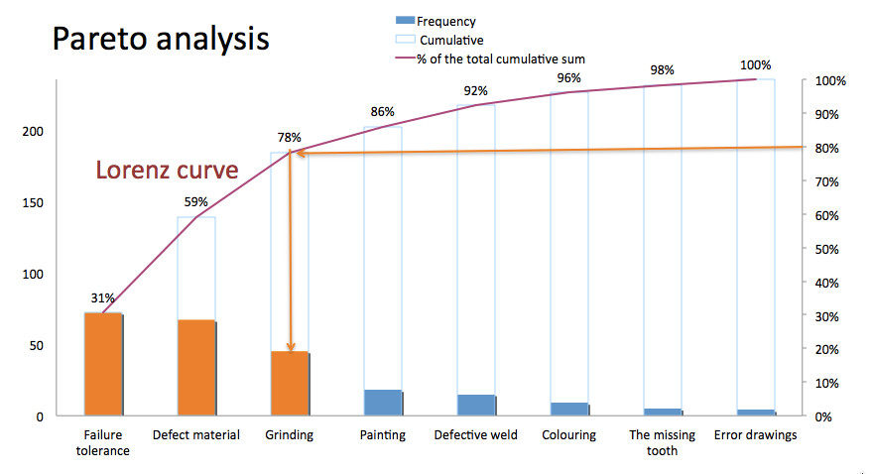
https://www.bing.com/images/search?view=detailV2&ccid=dRiquMUw&id=22DC99AA30CDCF472B2C2B9A1032E6F165E400E0&thid=OIP.dRiquMUwoHAJ-AautpVCCgEsCj&mediaurl=http%3a%2f%2fwww.ownway.eu%2fdata%2fUSR_001_USR_ADVICERS%2fUSR_292_PORADCE%2foriginal_Pareto%2520analysis%2520-%2520graph%2520EN.jpg&exph=478&expw=879&q=pareto+analysis&simid=608039282245109317&selectedIndex=3&ajaxhist=0

Slide 7

Root Cause Analysis Tools and Techniques
https://www.bing.com/videos/search?q=how+to+calculate+root+cause+analysis&&view=detail&mid=5BD4FFBF9F58D995CA805BD4FFBF9F58D995CA80&FORM=VRDGAR

Slide 8
Chapter 15
Embedding ERM into Strategic Planning at the City of Edmonton

Slide 9
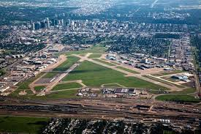
Notes:
City of Edmonton Historical Context and ERM Development – pages 281-284
Grown through 1880 settlements, rail connections, Klondike gold rush
Agricultural center, oil capital of Canada, oil sands development of northern Alberta
2003 the Office of the City Auditor created the beginning of the ERM framework – Corporate Business Risk Planning model
2005 Audit found the ERM was being used, but did not integrate into business plans
CFO was appointed sponsor for the ERM program
Audit committee of city governance had board responsibility
2011 a general Program Manager was added and an ERM working committee
2012 a ERM Program Manager was added to assist the Program Manager
The 5 question approach of the City of Edmonton to ERM – pg 283
What are our long-term vision and goals?
What strategy will help achieve the vision?
What objectives will achieve the strategy?
What performance measures will show whether the objectives are achieved?
What risks will interfere with achievement of the objectives?
These questions required results based budgeting model

Slide 10
  Results Based and Capital Modeling – pg 284-285
    Organizational-wide ERM assists in company resource allocation to appropriate areas and reduces inefficiency in profit maximization
    Monetary capital is properly focused on a risk/reward basis within a given organizational tolerance of risk
    Human capital is allocated, increased, or decreased based upon ERM strategic planning to maximize efficiencies and productivity
  Risk Scorecard Methodology – pg 286
    Weighing of goals to highest priority
    Incorporate strategic objectives to goals/mission
    Risks tied to each strategic objective
    Examination and pairing of existing projects to overall goals/strategy
    Identification of planned future projects linked to strategic goals
    Identification and/or creation of mitigation systems for high risk outcomes
  ERM process must be 2 things – pg 297
    Simple for everyone to gain knowledge of the process and deeply understand it in terms of their position and the company
    Show value of performing the necessary functions so that motivation and outcome combine

Slide 11
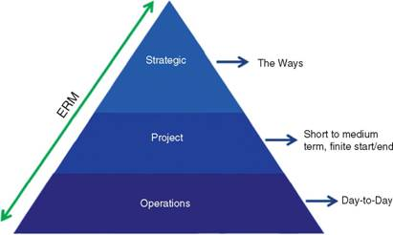
Edmonton City Strategic Risk Management Model
https://www.bing.com/images/search?view=detailV2&ccid=OHSJC18I&id=F55876B319EF6D509FBAA30363FD2624C2E195B9&thid=OIP.OHSJC18I7rW5oAsJCSFRsQEsCz&mediaurl=http%3a%2f%2facademlib.com%2fimag%2fmanag%2ffras_imperm%2fimage070.jpg&exph=246&expw=411&q=relationship+between+strategic%2c+project%2c+and+operational+risks&simid=608052566556935471&selectedIndex=2&ajaxhist=0

Slide 12
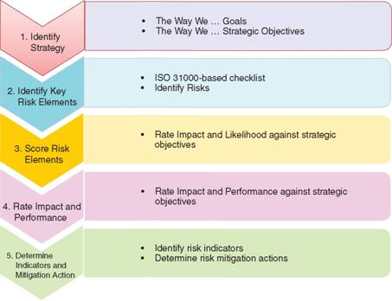
Montreal scoring of likelihood and impact of risk events
https://www.bing.com/images/search?view=detailV2&ccid=wNNFjuoK&id=9CE0D5BA401C68A127903D505AA72BA392E7C1E0&thid=OIP.wNNFjuoKyMBF5w-kX2wJTAEdDb&mediaurl=http%3a%2f%2facademlib.com%2fimag%2fmanag%2ffras_imperm%2fimage071.jpg&exph=348&expw=453&q=risk+scorecard+process+diagram&simid=608045162036596551&selectedIndex=1&ajaxhist=0

Slide 13
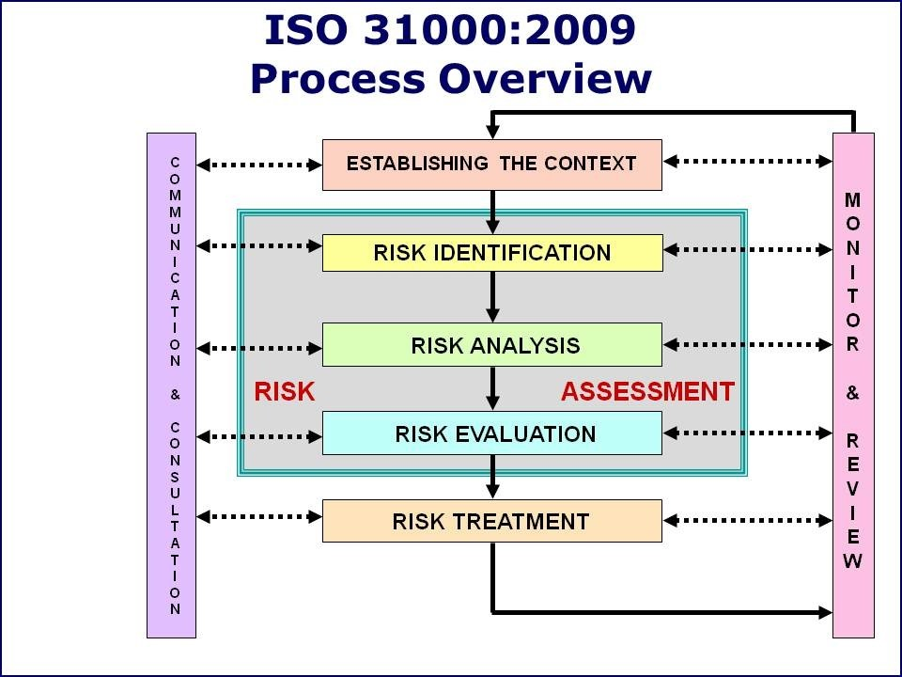
https://www.bing.com/images/search?view=detailV2&ccid=nYNJIoK4&id=9F3D93E5DE5A90534F4E78FA20E6EC096AFCD36B&thid=OIP.nYNJIoK4Pn41_5Y_WbgnfQEsDh&mediaurl=https%3a%2f%2fppl.app.uq.edu.au%2fsites%2fdefault%2ffiles%2fIS031000%2520Process%2520Diagram.jpg&exph=720&expw=960&q=enterprise+risk+management+process+chart&simid=608019959161226691&selectedIndex=8&ajaxhist=0

Slide 14
Chapter 19
Kilgore Custom Milling

Slide 15
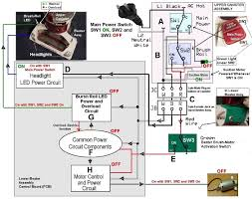
Notes:
Company background – pg 363-367
Small private manufacturer of power window assemblies for automobile manufacturers’ plants based in southern Ontario, Canada
Products are considered a commodity
Focus on low-cost manufacturing mainly in the Windsor and southwest Ontario areas
Availability of low labor and a low cost of manufacturing
Material costs dictated degree of profitability due to low cost strategy of production
Main risk – building sturdy and reliable quality parts with no needed technological changes or expected changes leaves little room for competitive advantage
Management team – pg 368
Owner – Steve MacLinden – 100% owner
Rory Sullivan – operational GM
Casey Dobbelstyn – Sales Manager
Cathy Williams – Treasurer/CFO
New contract bid – pg 369-374
Upside risks
Increase sales 100% over next five years
Double size of company
International exposure
Low operational risk due to compensation for any technical changes
Possible extension for 3 additional years
Downside risks
Small profit margin of 8%
Denominated in US dollars causing currency risks
Inflation differentials between US and Canada as contract uses US Producer Price Index (PPI)

Slide 16
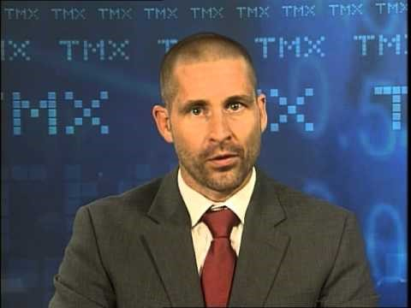
Currency Hedging Explanations
https://www.bing.com/videos/search?q=currency+risk+hedging+strategies&&view=detail&mid=9892D82E2B5DF489934A9892D82E2B5DF489934A&FORM=VRDGAR

Slide 17
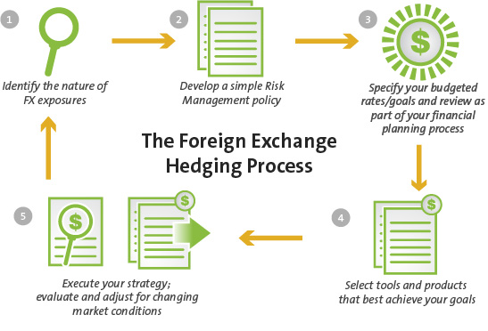
Currency Hedging Methodology
https://www.bing.com/images/search?view=detailV2&ccid=qXQ5E0Ec&id=952EE2519A39A20A28744407DAC0C7054B994121&thid=OIP.qXQ5E0EcGvzYWdpeQcjPhAHgFG&mediaurl=http%3a%2f%2flerablog.org%2fwp-content%2fuploads%2f2015%2f02%2ffx-hedging.png&exph=372&expw=547&q=currency+risk+hedging+strategies&simid=608015616989859798&selectedIndex=1&ajaxhist=0

Slide 18
Chapter 20
Implementing Risk Management within Middle Eastern Oil and Gas Companies

Slide 19
  Focus on ERM through IT and project management departments pg 377-380
    MECO includes 5 business lines
    Five administrative areas in each line
    2006 to 2008 – ERM team pursue formal project risk management as successful pilot program
    2010 – Second implementation of risk management to a company wide approach with inclusion of internal audit members
  IT Risk – largest risk is that of severe cyber attack
  Activity Risk Holder (ARH) was software chosen for IT projects and integration of ERM – pg 381-382
    Software allows risks and actions to be captured across an organization and project
    Mainly used and further developed for MECO by one person
    The risk management drive that contained all the data was lost and process halted
  Risk Management Approach to MECO IT and Project Management – pg 386-387
    Adopted ISO 31000
    Integrated a traffic light charting system to identify organization’s key risks
    Risk committee created to filter the corporate risk register and business lines to the management committee

Slide 20
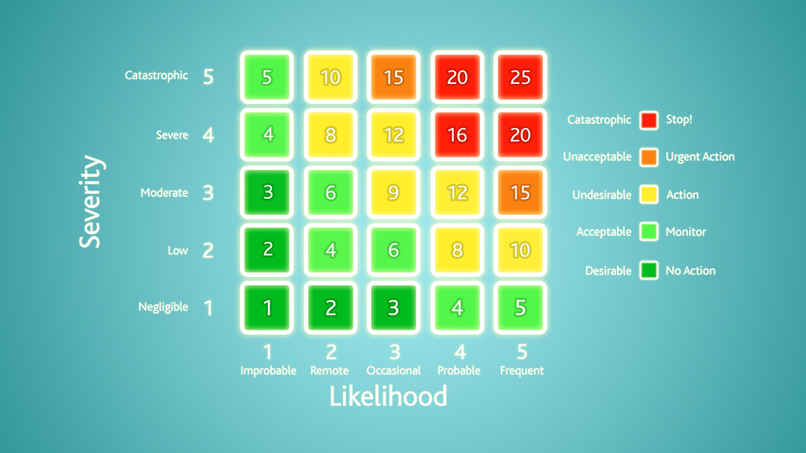
Traffic Light Risk Matrix Sample
https://www.bing.com/images/search?view=detailV2&ccid=vAE%2b17AB&id=CC45715935A53D205AE27A94435D77DC3246CA33&thid=OIP.vAE-17ABt2P-W9tdmJNhbQEsCo&mediaurl=http%3a%2f%2fnews.safetymedia.co.uk%2fwp-content%2fuploads%2f2016%2f04%2fRisk-Matrix.jpg&exph=540&expw=960&q=traffic+light+risk+managmenet+report&simid=608035562795174094&selectedIndex=4&ajaxhist=0

Slide 21
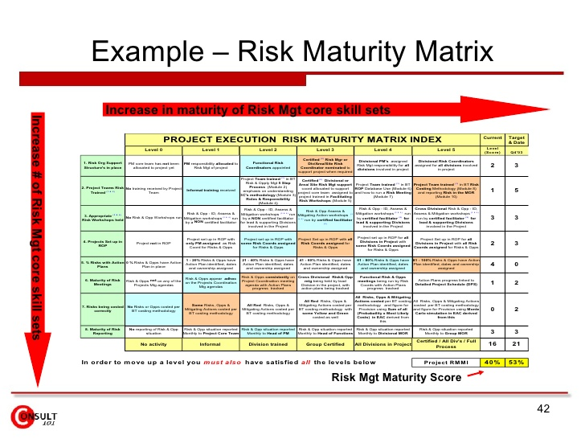
Risk Maturity Matrix
https://www.bing.com/images/search?view=detailV2&ccid=VY27s2ga&id=D0DDC9C9AF60BCE2CEA61587477D297088BB9A07&thid=OIP.VY27s2gaWvSuc3WVMk94YgEsDh&mediaurl=http%3a%2f%2fimage.slidesharecdn.com%2friskmanagementframework-090710200059-phpapp01%2f95%2frisk-management-framework-42-728.jpg&exph=546&expw=728&q=risk+maturity+matrix&simid=608050195739380696&selectedIndex=5&ajaxhist=0

Slide 22
Chapter 35
ERM at Malaysia's Media Company Astro: Quickly Implementing ERM and Using It to Assess the Risk-Adjusted Performance of a Portfolio of Acquired Foreign Companies

Slide 23

Notes:
2012 Malaysia’s Security Commission established a comply or explain code for risk management – pg 625
Sound framework of managed risks
Understand principal risks of all aspects of the business
Recognize business decisions involved taking of appropriate risks
Achieve balance between risks incurred and potential returns to shareholders
Ensure systems that effectively monitor and manage risks
Company risk tolerance and tie to key business risks to safeguard shareholders
Annual report disclosure of main risk management framework and internal control
ERM framework within Astro Overseas Limited (AOL) – pg 629-636
Company responsible for all international investments
Migration of the ERM from disaster recovery, business continuity, to full enterprise risk management
ERM directly integrated into company acquisition processes
Preacquisition – Gain preliminary acquisition process
Monitor and Review phase – expands preacquisition and coordination of strategic objectives
Post acquisition – execution of ERM into new company and set up of exit/divestment strategy
Phase 1 – 30 days with awareness training sessions and interview stage
Phase II – 20 days combining top down and bottom up approaches to strategy and ERM
Phase III – 10 days with sustainability step and integration into new acquisition

Slide 24
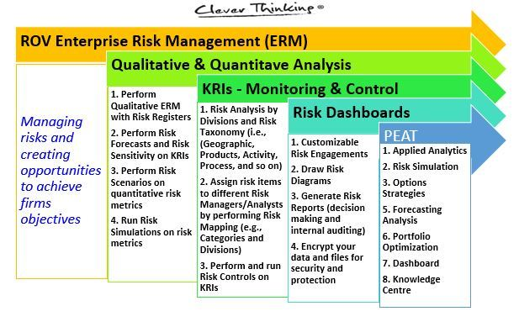
Typical ERM System Applicable to Company Acquisitions
https://www.bing.com/images/search?view=detailV2&ccid=9BMfEeK4&id=2F73B5587127A0F16DEEF54403CB88BF50E357EE&thid=OIP.9BMfEeK4k6BO9vw7MTf4sAE9DE&mediaurl=http%3a%2f%2fwww.oslriskmanagement.com%2fuploads%2foptimadmin%2fimage%2fimage%2f32%2fROV_ERM.JPG&exph=383&expw=617&q=ERM+implementation+for+venture+capital+firms&simid=608020496031025654&selectedIndex=3&ajaxhist=0
Notes:
https://www.bing.com/images/search?view=detailV2&ccid=9BMfEeK4&id=2F73B5587127A0F16DEEF54403CB88BF50E357EE&thid=OIP.9BMfEeK4k6BO9vw7MTf4sAE9DE&mediaurl=http%3a%2f%2fwww.oslriskmanagement.com%2fuploads%2foptimadmin%2fimage%2fimage%2f32%2fROV_ERM.JPG&exph=383&expw=617&q=ERM+implementation+for+venture+capital+firms&simid=608020496031025654&selectedIndex=3&ajaxhist=0

Slide 25
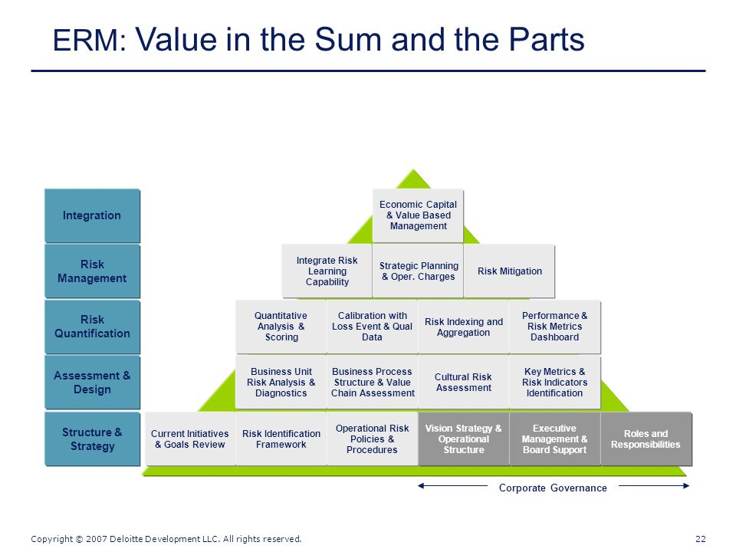
https://www.bing.com/images/search?view=detailV2&ccid=xBvm%2bCAs&id=691DCCB88AAE151F13F6776D25E38F8F435533D7&thid=OIP.xBvm-CAsIBF4aU7J-OT1GQEgDY&mediaurl=http%3a%2f%2fslideplayer.com%2f6833617%2f23%2fimages%2f23%2fERM%253A%2bValue%2bin%2bthe%2bSum%2bof%2bthe%2bParts.jpg&exph=720&expw=960&q=erm+reporting+and+monitoring+structure&simid=608052003914845417&selectedIndex=7&ajaxhist=0
Notes:
https://www.bing.com/images/search?view=detailV2&ccid=xBvm%2bCAs&id=691DCCB88AAE151F13F6776D25E38F8F435533D7&thid=OIP.xBvm-CAsIBF4aU7J-OT1GQEgDY&mediaurl=http%3a%2f%2fslideplayer.com%2f6833617%2f23%2fimages%2f23%2fERM%253A%2bValue%2bin%2bthe%2bSum%2bof%2bthe%2bParts.jpg&exph=720&expw=960&q=erm+reporting+and+monitoring+structure&simid=608052003914845417&selectedIndex=7&ajaxhist=0

Slide 26
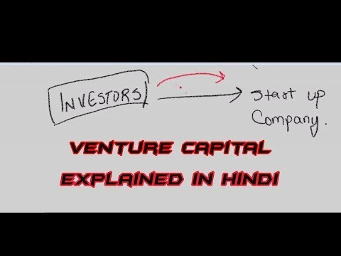
What is Venture Capital
Notes:
https://www.bing.com/videos/search?q=ERM+venture+capital+explanation&&view=detail&mid=9B7A66353FC02ABF5CBE9B7A66353FC02ABF5CBE&FORM=VRDGAR

Slide 27
References
John R.S. Fraser, B. J. (2015). Implementing Enterprise Risk Management. New Jersey: Wiley & Son, Inc.,

